Slide 1
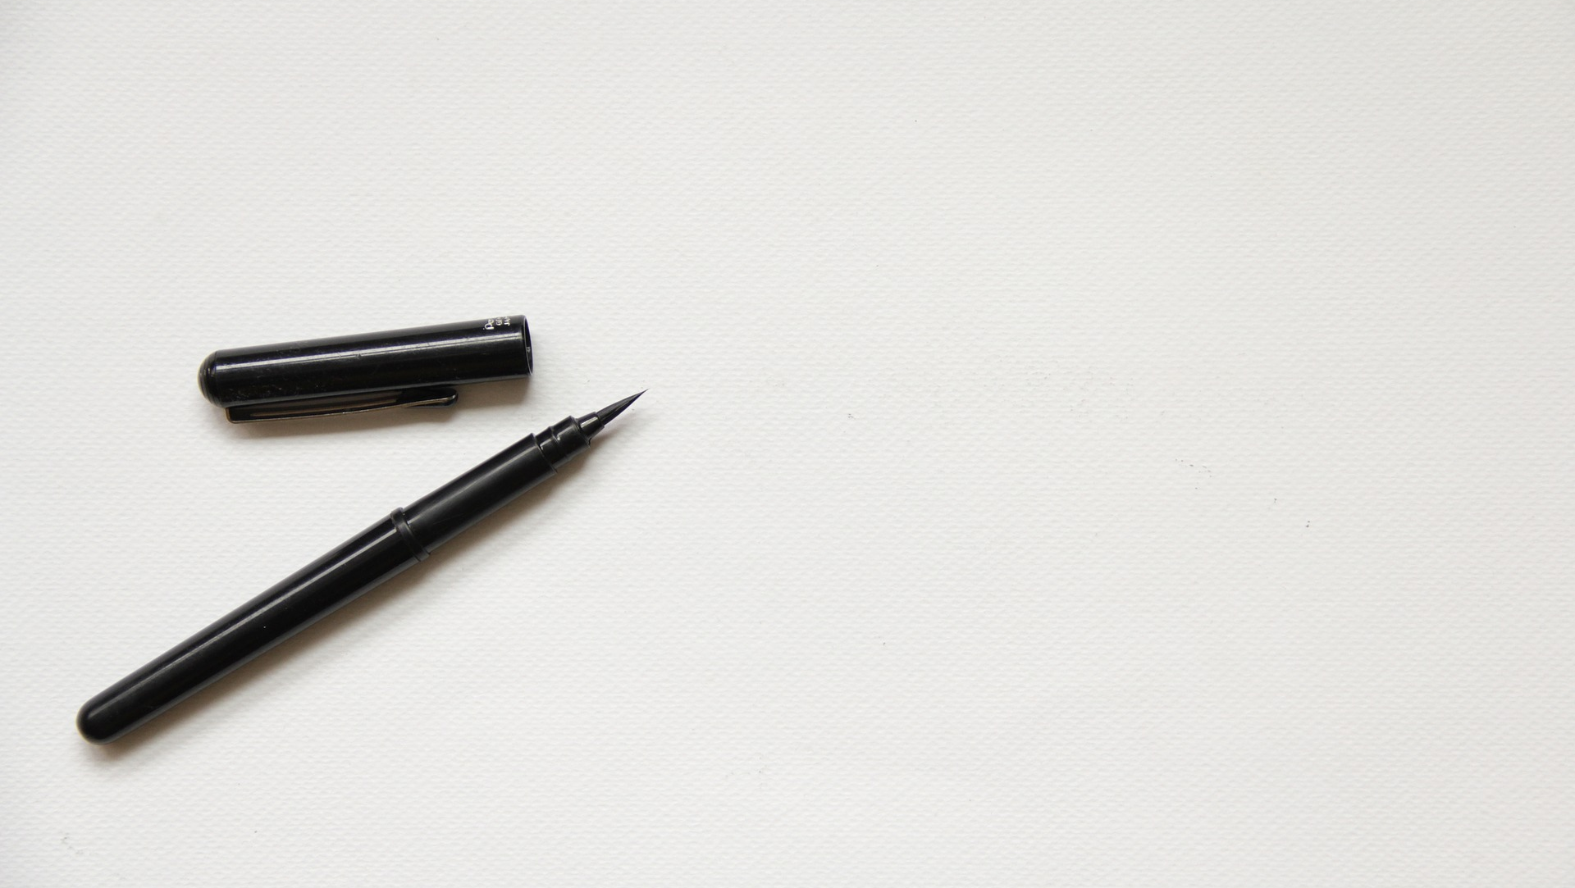

OPEN CV
Seminar
4th WEEK
10/02
박소민

Slide 2

Open cv
03 자연마커 AR
1. 소스 및 헤더 파일
main
CameraCalibration
GeometryTypes
ARPipeline
ARDrawingContext
Pattern
PatternDetector
CV에 포함된 GL 사용하지 않고
freeglut, glew 라이브러리 사용하기 위해
통합

Slide 3
Open cv
03 자연마커 AR
1. main()
GLOBAL 변수
CameraCalibration calibration(526.58037684199849f, 524.65577209994706f, 318.41744018680112f, 202.96659047014398f);
VideoCapture cap(0);
Mat patternImage = imread("PyramidPattern.jpg");
Mat testImage;
ARPipeline pipeline(patternImage, calibration);
bool m_isTextureInitialized = false;
unsigned int m_backgroundTextureId;
Mat m_backgroundImage;
bool isPatternPresent = false;
Transformation patternPose;
ARDrawingContext

Slide 4
Open cv
03 자연마커 AR
1. main
main(int argc, char ** argv) {
void idle() {
testImage = imread("PyramidPatternTest.bmp");
if (patternImage.empty()) return 0;
glutInit(&argc, argv);
glutInitDisplayMode(GLUT_DOUBLE | GLUT_RGBA | GLUT_DEPTH);
glutInitWindowSize(testImage.cols, testImage.rows);
glewInit();
glutCreateWindow("Markerless AR");
glutIdleFunc(idle);
glutDisplayFunc(draw);
glutMainLoop();
return 0; }
processVideo(patternImage, calibration, cap, pipeline);
processSingleImage(patternImage, calibration, testImage,pipeline);
glutPostRedisplay(); }
void draw() {
glClear(GL_DEPTH_BUFFER_BIT |GL_COLOR_BUFFER_BIT);
if (!cap.isOpened()) return;
drawCameraFrame();
drawAugmentedScene();
glutSwapBuffers(); }

Slide 5
Open cv
03 자연마커 AR
1. main
void idle() {
processVideo(patternImage, calibration, cap, pipeline);
processSingleImage(patternImage, calibration, testImage,pipeline);
glutPostRedisplay(); }
void processSingleImage(
const cv::Mat& patternImage, CameraCalibration& calibration, const cv::Mat& image, ARPipeline& pipeline){
void processVideo(
const cv::Mat& patternImage, CameraCalibration& calibration, const cv::Mat& image, ARPipeline& pipeline){
Mat currentFrame;
capture >> currentFrame;
if (currentFrame.empty()) return;
processFrame(currentFrame, pipeline);
}
processFrame(image, pipeline);
}

Slide 6
Open cv
03 자연마커 AR
1. main
void processFrame(const Mat& cameraFrame, ARPipeline& pipeline) {
Mat img = cameraFrame.clone();
img.copyTo(m_backgroundImage); // AR 배경에 그릴 이미지
isPatternPresent = pipeline.processFrame(cameraFrame);
patternPose = pipeline.getPatternLocation(); }
ARPipeline pipeline(patternImage,calibration)

Slide 7
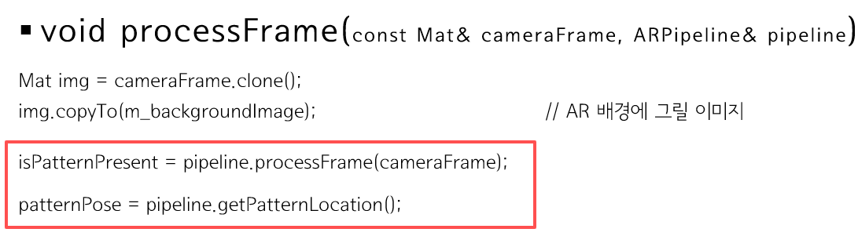
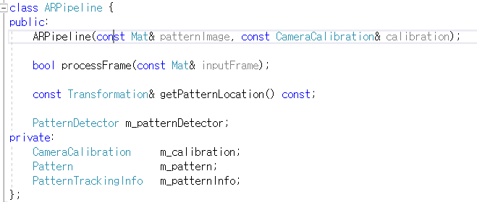
Open cv
03 자연마커 AR
2. ARPipeline
ARPipeline Class
bool ARPipeline::processFrame(const Mat& inputFrame) {
bool patternFound = m_patternDetector.findPattern(inputFrame, m_patternInfo);
if (patternFound) m_patternInfo.computePose(m_pattern, m_calibration);
return patternFound; }
ARPipeline 생성자
: m_calibration(calibration)
{
m_patternDetector.buildPatternFromImage
(patternImage, m_pattern);
m_patternDetector.train(m_pattern); }
const Transformation& ARPipeline::getPatternLocation() const {
return m_patternInfo.pose3d; }

Slide 8
Open cv
03 자연마커 AR
2. ARPipeline
ARPipeline Class
bool ARPipeline::processFrame(const Mat& inputFrame) {
bool patternFound = m_patternDetector.findPattern(inputFrame, m_patternInfo);
if (patternFound) m_patternInfo.computePose(m_pattern, m_calibration);
return patternFound; }
ARPipeline
PatternDetector
Pattern
ARPipeline 생성자
: m_calibration(calibration)
{
m_patternDetector.buildPatternFromImage
(patternImage, m_pattern);
m_patternDetector.train(m_pattern); }
const Transformation& ARPipeline::getPatternLocation() const {
return m_patternInfo.pose3d; }
Pattern

Slide 9
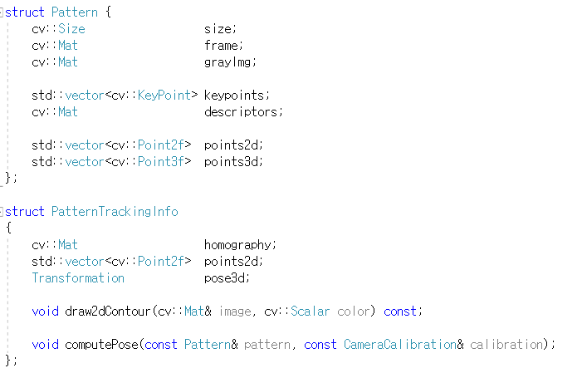
Open cv
03 자연마커 AR
3. Pattern
Pattern Structure
void PatternTrackingInfo::computePose(const Pattern& pattern, const CameraCalibration& calibration){
Mat Rvec; Mat_<float> Tvec; Mat raux, taux;
solvePnP(pattern.points3d, points2d, calibration.getIntrinsic(), calibration.getDistorsion(), raux, taux);
raux.convertTo(Rvec, CV_32F);
taux.convertTo(Tvec, CV_32F);
Mat_<float> rotMat(3, 3);
Rodrigues(Rvec, rotMat);
for (int col = 0; col < 3; col++) {
for (int row = 0; row < 3; row++)
pose3d.r().mat[row][col] = rotMat(row, col);
pose3d.t().data[col] = Tvec(col); }
pose3d = pose3d.getInverted(); }
computePose는
카메라의 위치와 회전 벡터를 pose3d에 저장
PatternDetector

Slide 10
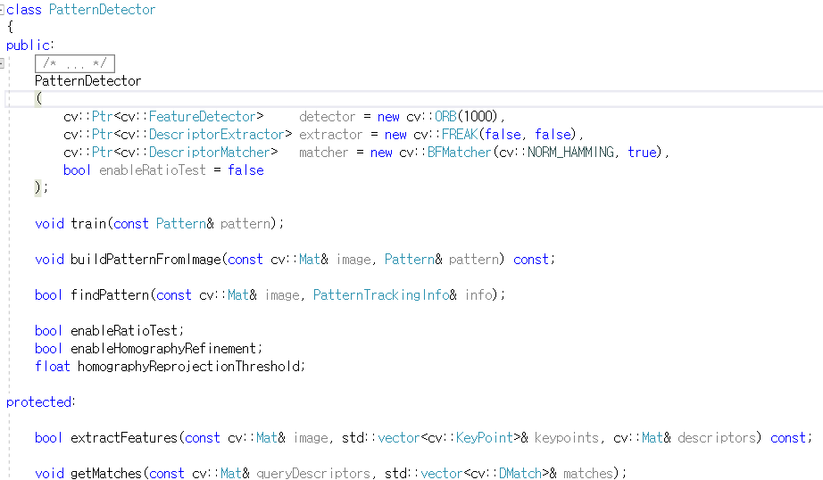
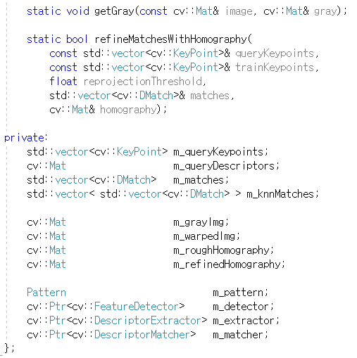
Open cv
03 자연마커 AR
4. PatternDetector
PatternDetector Class

Slide 11
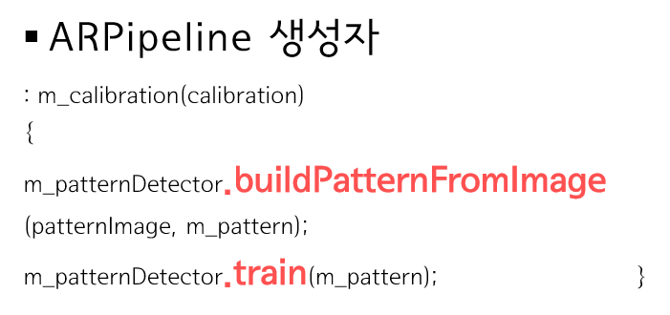
Open cv
03 자연마커 AR
4. PatternDetector
void PatternDetector:: buildPatternFromImage(const Mat& image, Pattern& pattern) const {
int numImages = 4;
float step = sqrtf(2.0f);
pattern.size = Size(image.cols, image.rows);
pattern.frame = image.clone();
getGray(image, pattern.grayImg);
pattern.points2d.resize(4); pattern.points3d.resize(4);
const float w = image.cols; const float h = image.rows;
const float maxSize = max(w, h);
const float unitW = w / maxSize;
const float unitH = h / maxSize;
pattern.points2d[0] = Point2f(0, 0);
pattern.points2d[1] = Point2f(w, 0);
pattern.points2d[2] = Point2f(w, h);
pattern.points2d[3] = Point2f(0, h);
pattern.points3d[0] = Point3f(-unitW, -unitH, 0);
pattern.points3d[1] = Point3f(unitW, -unitH, 0);
pattern.points3d[2] = Point3f(unitW, unitH, 0);
pattern.points3d[3] = Point3f(-unitW, unitH, 0);
extractFeatures(pattern.grayImg, pattern.keypoints, pattern.descriptors);
}
SolvePnP

Slide 12
Open cv
03 자연마커 AR
4. PatternDetector
bool PatternDetector::extractFeatures
(const Mat& image, vector<KeyPoint>& keypoints, Mat& descriptors) const {
void PatternDetector::train(const Pattern& pattern) {
m_pattern = pattern;
m_matcher->clear();
vector<Mat> descriptors(1);
descriptors[0] = pattern.descriptors.clone();
m_matcher->add(descriptors);
m_matcher->train(); }
assert(!image.empty());
assert(image.channels() == 1);
m_detector->detect(image, keypoints);
if (keypoints.empty())
return false;
m_extractor->compute(image, keypoints, descriptors);
if (keypoints.empty())
return false;
return true; }
ARPipeline pipeline 생성

Slide 13
Open cv
bool ARPipeline::processFrame(const Mat& inputFrame) {
bool patternFound = m_patternDetector.findPattern(inputFrame, m_patternInfo);
if (patternFound) m_patternInfo.computePose(m_pattern, m_calibration);
return patternFound; }
03 자연마커 AR
4. PatternDetector
const Transformation& ARPipeline::getPatternLocation() const {
bool PatternDetector::extractFeatures
(const Mat& image, vector<KeyPoint>& keypoints, Mat& descriptors) const {
void PatternDetector::train(const Pattern& pattern) {
return m_patternInfo.pose3d; }
m_pattern = pattern;
m_matcher->clear();
vector<Mat> descriptors(1);
descriptors[0] = pattern.descriptors.clone();
m_matcher->add(descriptors);
m_matcher->train(); }
assert(!image.empty());
assert(image.channels() == 1);
m_detector->detect(image, keypoints);
if (keypoints.empty())
return false;
m_extractor->compute(image, keypoints, descriptors);
if (keypoints.empty())
return false;
return true; }
pipeline 생성
pipeline 함수
ARPipeline pipeline 생성

Slide 14
Open cv
bool ARPipeline::processFrame(const Mat& inputFrame) {
bool patternFound = m_patternDetector.findPattern(inputFrame, m_patternInfo);
if (patternFound) m_patternInfo.computePose(m_pattern, m_calibration);
return patternFound; }
03 자연마커 AR
4. PatternDetector_ProcessFrame
void PatternDetector:: findPattern(const Mat& image, PatternTrackingInfo& info) {
getGray(image, m_grayImg);
extractFeatures(m_grayImg, m_queryKeypoints, m_queryDescriptors);
getMatches(m_queryDescriptors, m_matches);
bool homographyFound = refineMatchesWithHomography(m_queryKeypoints, m_pattern.keypoints, homographyReprojectionThreshold, m_matches, m_roughHomography);
if (homographyFound) {
}
return homographyFound; }
if (enableHomographyRefinement) {
warpPerspective(m_grayImg, m_warpedImg, m_roughHomography, m_pattern.size, WARP_INVERSE_MAP | INTER_CUBIC);
vector<KeyPoint> warpedKeypoints; vector<DMatch> refinedMatches;
extractFeatures(m_warpedImg, warpedKeypoints, m_queryDescriptors);
getMatches(m_queryDescriptors, refinedMatches);
homographyFound = refineMatchesWithHomography(warpedKeypoints, m_pattern.keypoints, homographyReprojectionThreshold, refinedMatches, m_refinedHomography);
info.homography = m_roughHomography * m_refinedHomography;
perspectiveTransform(m_pattern.points2d, info.points2d, info.homography);} else { info.homography = m_roughHomography;
perspectiveTransform(m_pattern.points2d, info.points2d, m_roughHomography); }

Slide 15
Open cv
bool ARPipeline::processFrame(const Mat& inputFrame) {
bool patternFound = m_patternDetector.findPattern(inputFrame, m_patternInfo);
if (patternFound) m_patternInfo.computePose(m_pattern, m_calibration);
return patternFound; }
03 자연마커 AR
4. PatternDetector_ProcessFrame
void PatternDetector::getMatches(const Mat&queryDescriptors, vector<DMatch>& matches){
matches.clear();
if (enableRatioTest) {
const float minRatio = 1.f / 1.5f;
m_matcher->knnMatch(queryDescriptors, m_knnMatches, 2);
for (size_t i = 0; i < m_knnMatches.size(); i++) {
const DMatch& bestMatch = m_knnMatches[i][0];
const DMatch& betterMatch = m_knnMatches[i][1];
float distanceRatio = bestMatch.distance / betterMatch.distance;
if (distanceRatio < minRatio)
matches.push_back(bestMatch);
}
}
else {
m_matcher->match(queryDescriptors, matches);
} }

Slide 16
Open cv
bool ARPipeline::processFrame(const Mat& inputFrame) {
bool patternFound = m_patternDetector.findPattern(inputFrame, m_patternInfo);
if (patternFound) m_patternInfo.computePose(m_pattern, m_calibration);
return patternFound; }
03 자연마커 AR
4. PatternDetector_findPattern
void PatternDetector::refineMatchesWithHomography(const vector<KeyPoint>& queryKeypoints, const vector<KeyPoint>& trainKeypoints, float reprojectionThreshold, vector<DMatch>& matches, Mat& homography) {
const int minNumberMatchesAllowed = 8;
if (matches.size() < minNumberMatchesAllowed)
return false;
vector<Point2f> srcPoints(matches.size());
vector<Point2f> dstPoints(matches.size());
for (size_t i = 0; i < matches.size(); i++) {
srcPoints[i] = trainKeypoints[matches[i].trainIdx].pt;
dstPoints[i] = queryKeypoints[matches[i].queryIdx].pt;
}
vector<unsigned char> inliersMask(srcPoints.size());
homography = findHomography(srcPoints, dstPoints, CV_FM_RANSAC, reprojectionThreshold, inliersMask);
vector<DMatch> inliers;
for (size_t i = 0; i < inliersMask.size(); i++)
if (inliersMask[i]) inliers.push_back(matches[i]);
matches.swap(inliers);
return matches.size() >minNumberMatchesAllowed; }

Slide 17
Open cv
bool ARPipeline::processFrame(const Mat& inputFrame) {
bool patternFound = m_patternDetector.findPattern(inputFrame, m_patternInfo);
if (patternFound) m_patternInfo.computePose(m_pattern, m_calibration);
return patternFound; }
03 자연마커 AR
4. PatternDetector_findPattern
void PatternDetector::refineMatchesWithHomography(const vector<KeyPoint>& queryKeypoints, const vector<KeyPoint>& trainKeypoints, float reprojectionThreshold, vector<DMatch>& matches, Mat& homography) {
const int minNumberMatchesAllowed = 8;
if (matches.size() < minNumberMatchesAllowed)
return false;
vector<Point2f> srcPoints(matches.size());
vector<Point2f> dstPoints(matches.size());
for (size_t i = 0; i < matches.size(); i++) {
srcPoints[i] = trainKeypoints[matches[i].trainIdx].pt;
dstPoints[i] = queryKeypoints[matches[i].queryIdx].pt;
}
isPatternPresent
vector<unsigned char> inliersMask(srcPoints.size());
homography = findHomography(srcPoints, dstPoints, CV_FM_RANSAC, reprojectionThreshold, inliersMask);
vector<DMatch> inliers;
for (size_t i = 0; i < inliersMask.size(); i++)
if (inliersMask[i]) inliers.push_back(matches[i]);
matches.swap(inliers);
return matches.size() >minNumberMatchesAllowed; }
computePose는 카메라의 위치와 회전 벡터를 pose3d에 저장
(Pattern)

Slide 18
Open cv
pipeline()
patternDetector
.buildPatternFromImage
patternDetector.train
PatternDetector
.extractFeatures
ARPipeline pipeline
03 자연마커 AR
5. 순서
main
idle
draw
idle
processVideo
processSingleImage
processFrame
pipeline.processFrame
pieline.getPatternLocation
processFrame
extractFeatures
getMatches
refineMatchesWithHomography
warpPerspective
extractFeatures
getMatches
refineMatchesWithHomography
perspectiveTransform
PatternDetector.findPattern
Pattern.computePose

